Slide 1
Yuvaraj .S
813821104125
Computer Science and Engineering
yuvarajsekar241@gmail.com
Final Project

Slide 2
PROJECT TITLE
GENDER AGE DETECTION SYSTEM

Slide 3


AGENDA
The age and gender classification system is used to categorize human images into various groups determined by facial features. Estimating human age group and gender automatically via facial image analysis has lots of potential real-world applications, such as human computer interaction and multimedia communication.
The successful applications of CNN on many computer-vision tasks have revealed that CNN is a powerful tool in image learning. If enough training data are given, CNN is able to learn a compact and discriminative image feature representation.
This project aims to detect age and gender which works on the mechanism of deep learning using convolutional neural network.
3/21/2024 Annual Review

Slide 4

PROBLEM STATEMENT
The problem of gender and age detection involves identifying the gender and approximate age group of individuals from images.
It is a fundamental task in computer vision with numerous real-world applications including marketing, security, healthcare, and entertainment.
The challenge lies in accurately classifying individuals into predefined gender categories (male/female) and age groups (e.g., child, teenager, adult, senior).

Slide 5

PROJECT OVERVIEW
The Gender detection problem is a binary classification, while age detection is a multi-class classification problem. In general, to address the problems of Gender and age detection, signal and image processing followed by pattern classification techniques are applied to handwriting signals or images

Slide 6

WHO ARE THE END USERS?
Marketing and Advertising Companies,
Security and Surveillance Agencies,
Healthcare Professionals,
Entertainment Industry,
Retailers and E-commerce Platforms,
Educational Institutions,
Government Agencies and Policy Makers,
Social Media Platforms and Tech Companies.

Slide 7

YOUR SOLUTION AND ITS VALUE PROPOSITION
Our solution provides accurate gender and age classification,scalable processing,customization options, and ethical safeguards, empowering organizations with actionable insights and enhancing user experiences.

Slide 8

THE WOW IN YOUR SOLUTION
Our Gender and Age Detection System's unique factor lies in its innovative approach, combining cutting-edge deep learning techniques with real-time adaptability. Unlike traditional solutions, it dynamically adjusts to changing conditions, ensuring unparalleled accuracy and usability. This human-centric design, coupled with ethical transparency, sets us apart as industry leaders, empowering organizations with transformative insights and capabilities.
3/21/2024 Annual Review

Slide 9
MODELLING
Modelling the Gender and Age Detection System involves meticulous data collection, selecting appropriate deep learning architectures, training and fine-tuning models, evaluating performance metrics, and deploying them in real-world applications. This process ensures accurate and reliable gender and age classification capabilities to meet diverse user needs.

Slide 10
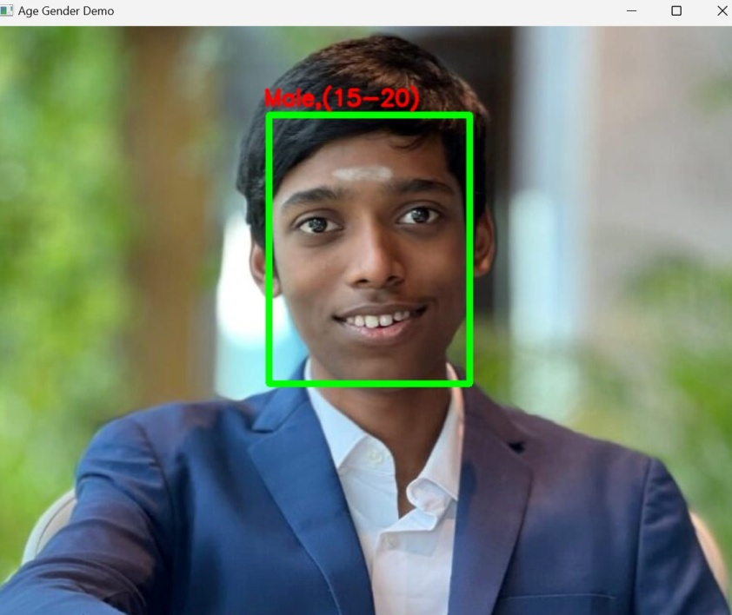
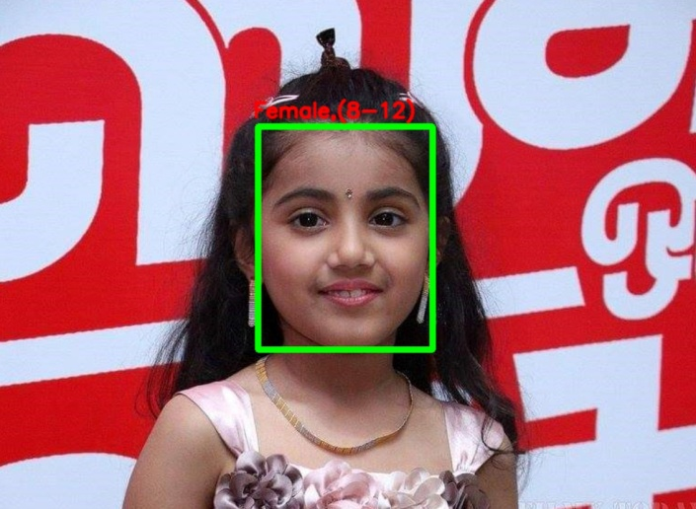
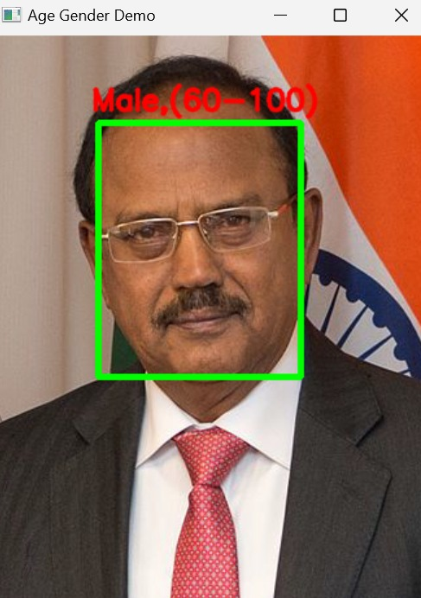
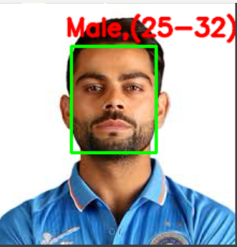
RESULTS
Project Link

